Slide 1

3,5 muškarca
Ready, steady, code !

Slide 2



Web application
Web app and admin panel
Define new locations
Choose from a set of most popular
questions
Define new, interesting quizzes

Slide 3
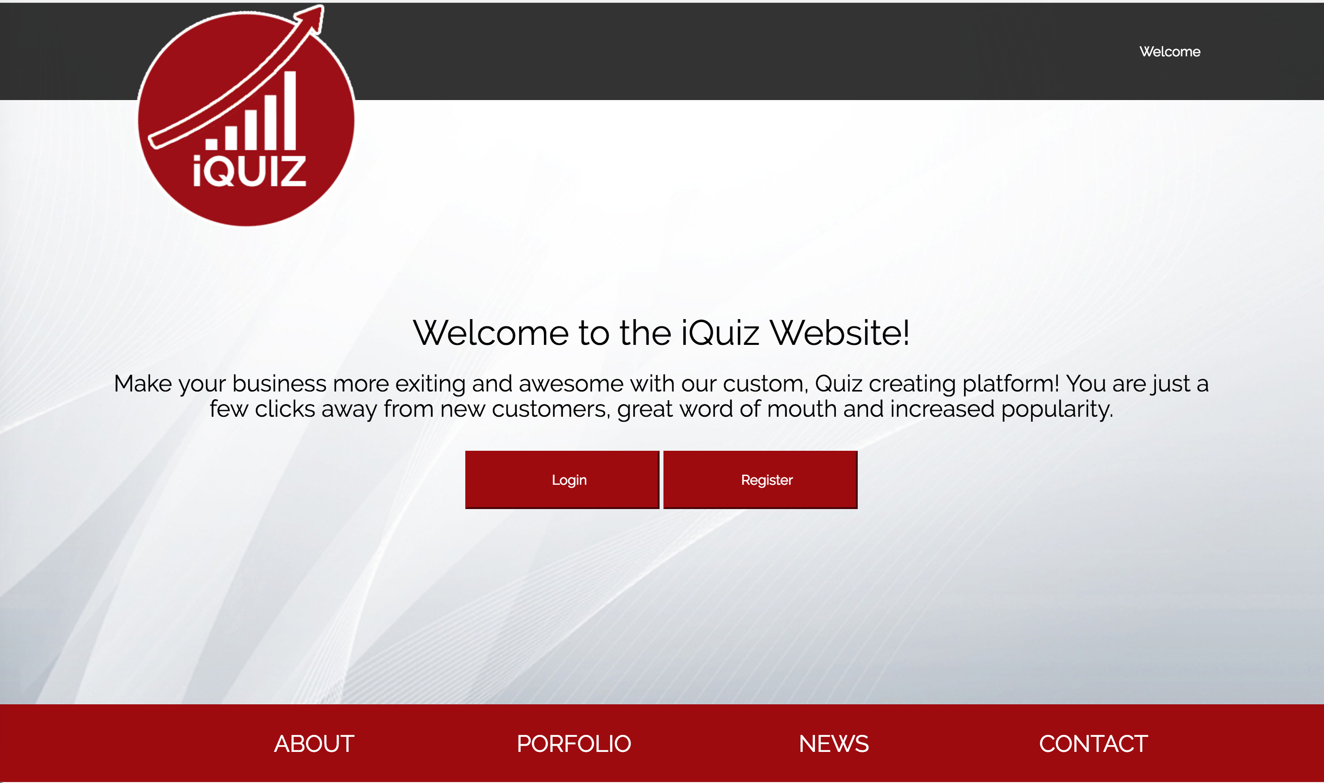

Slide 4
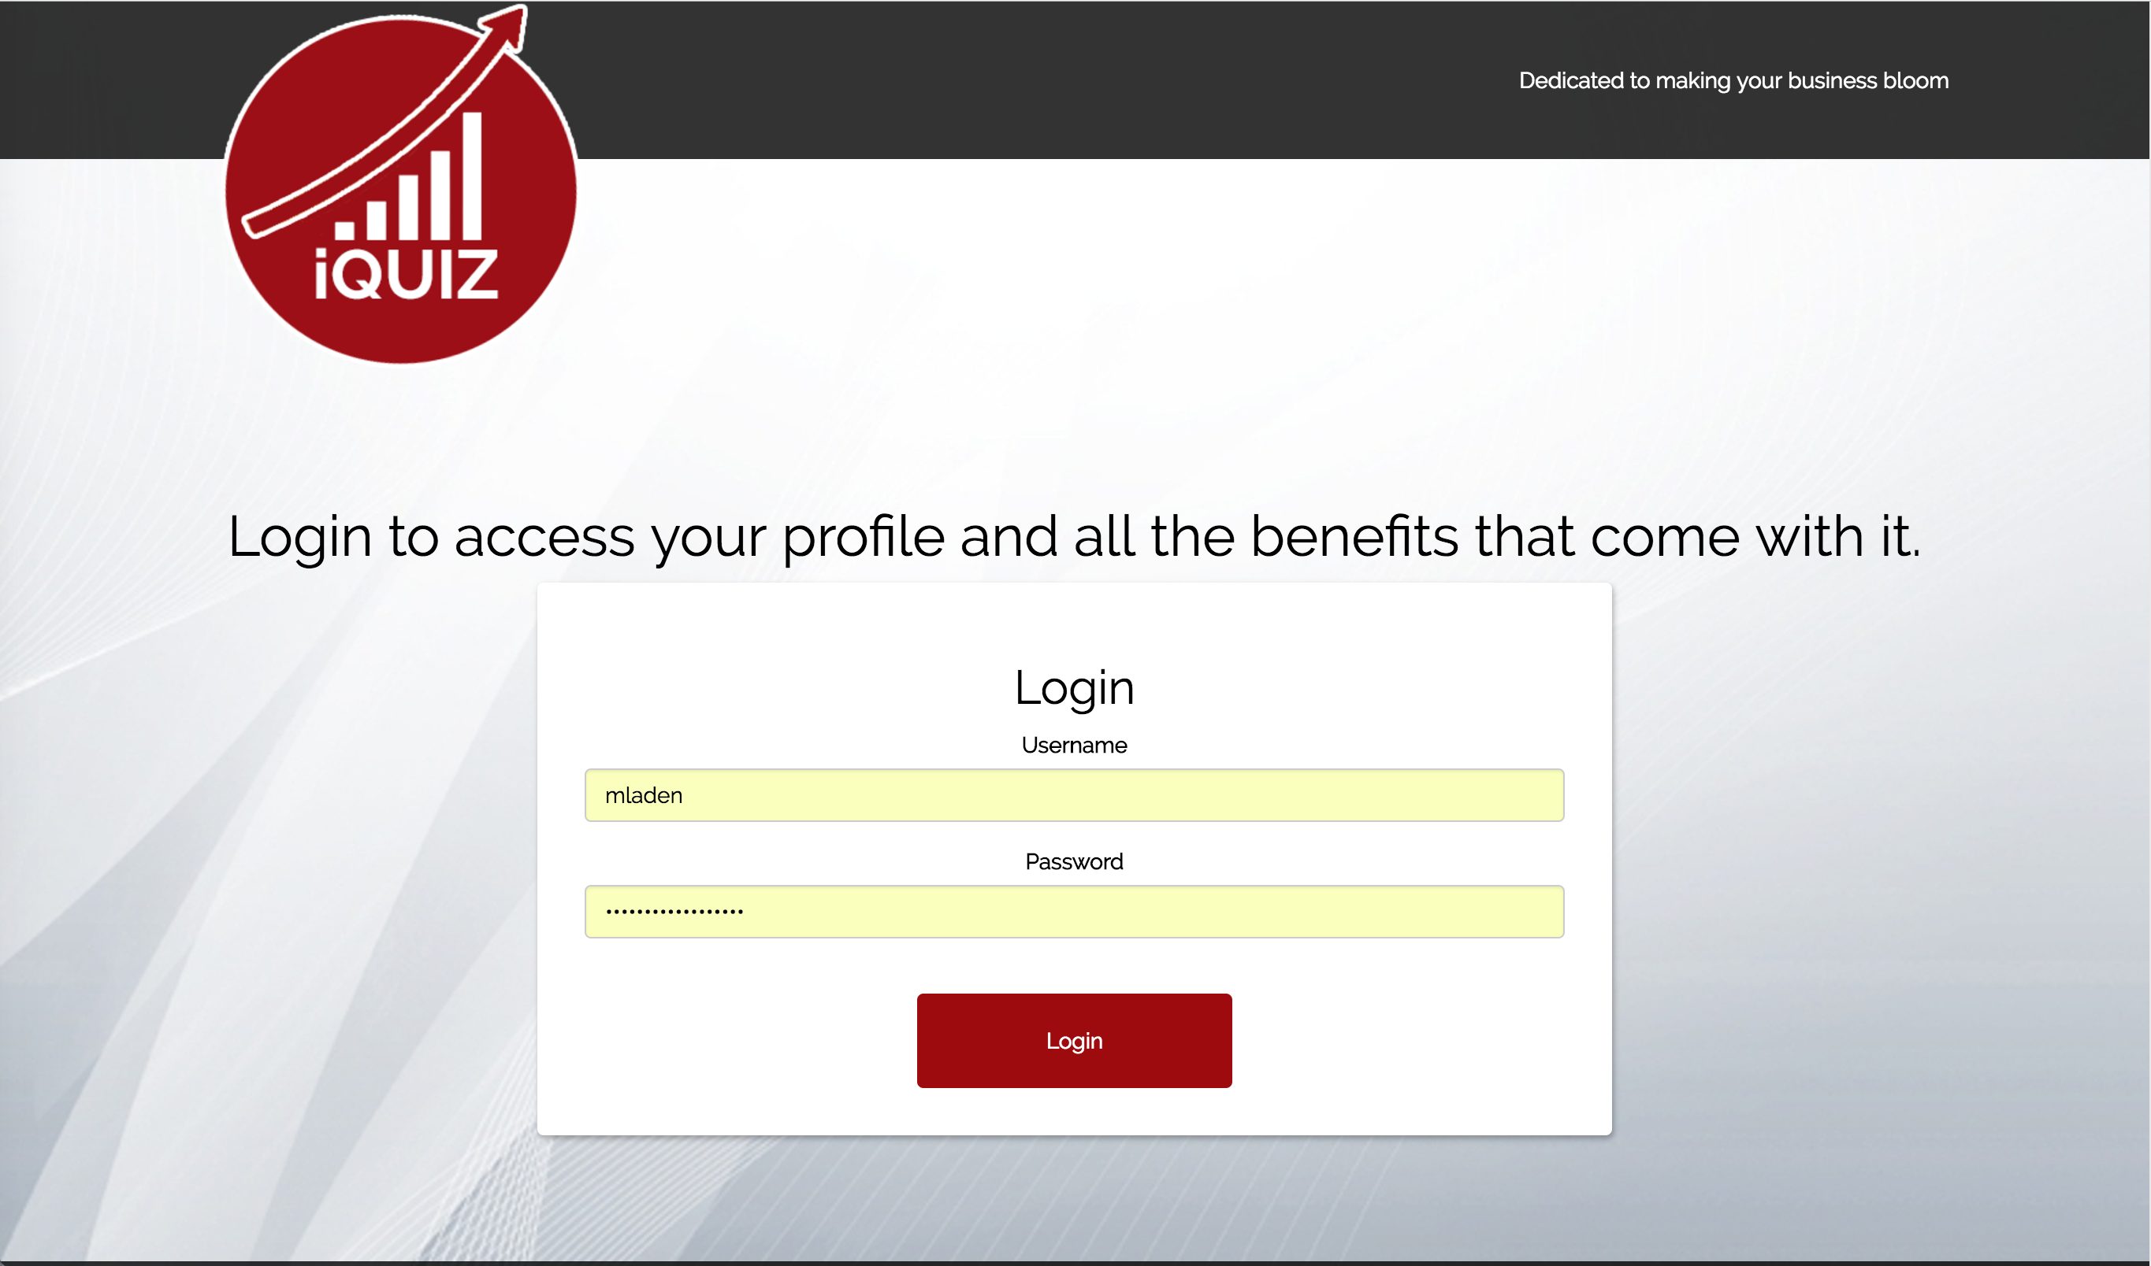

Slide 5
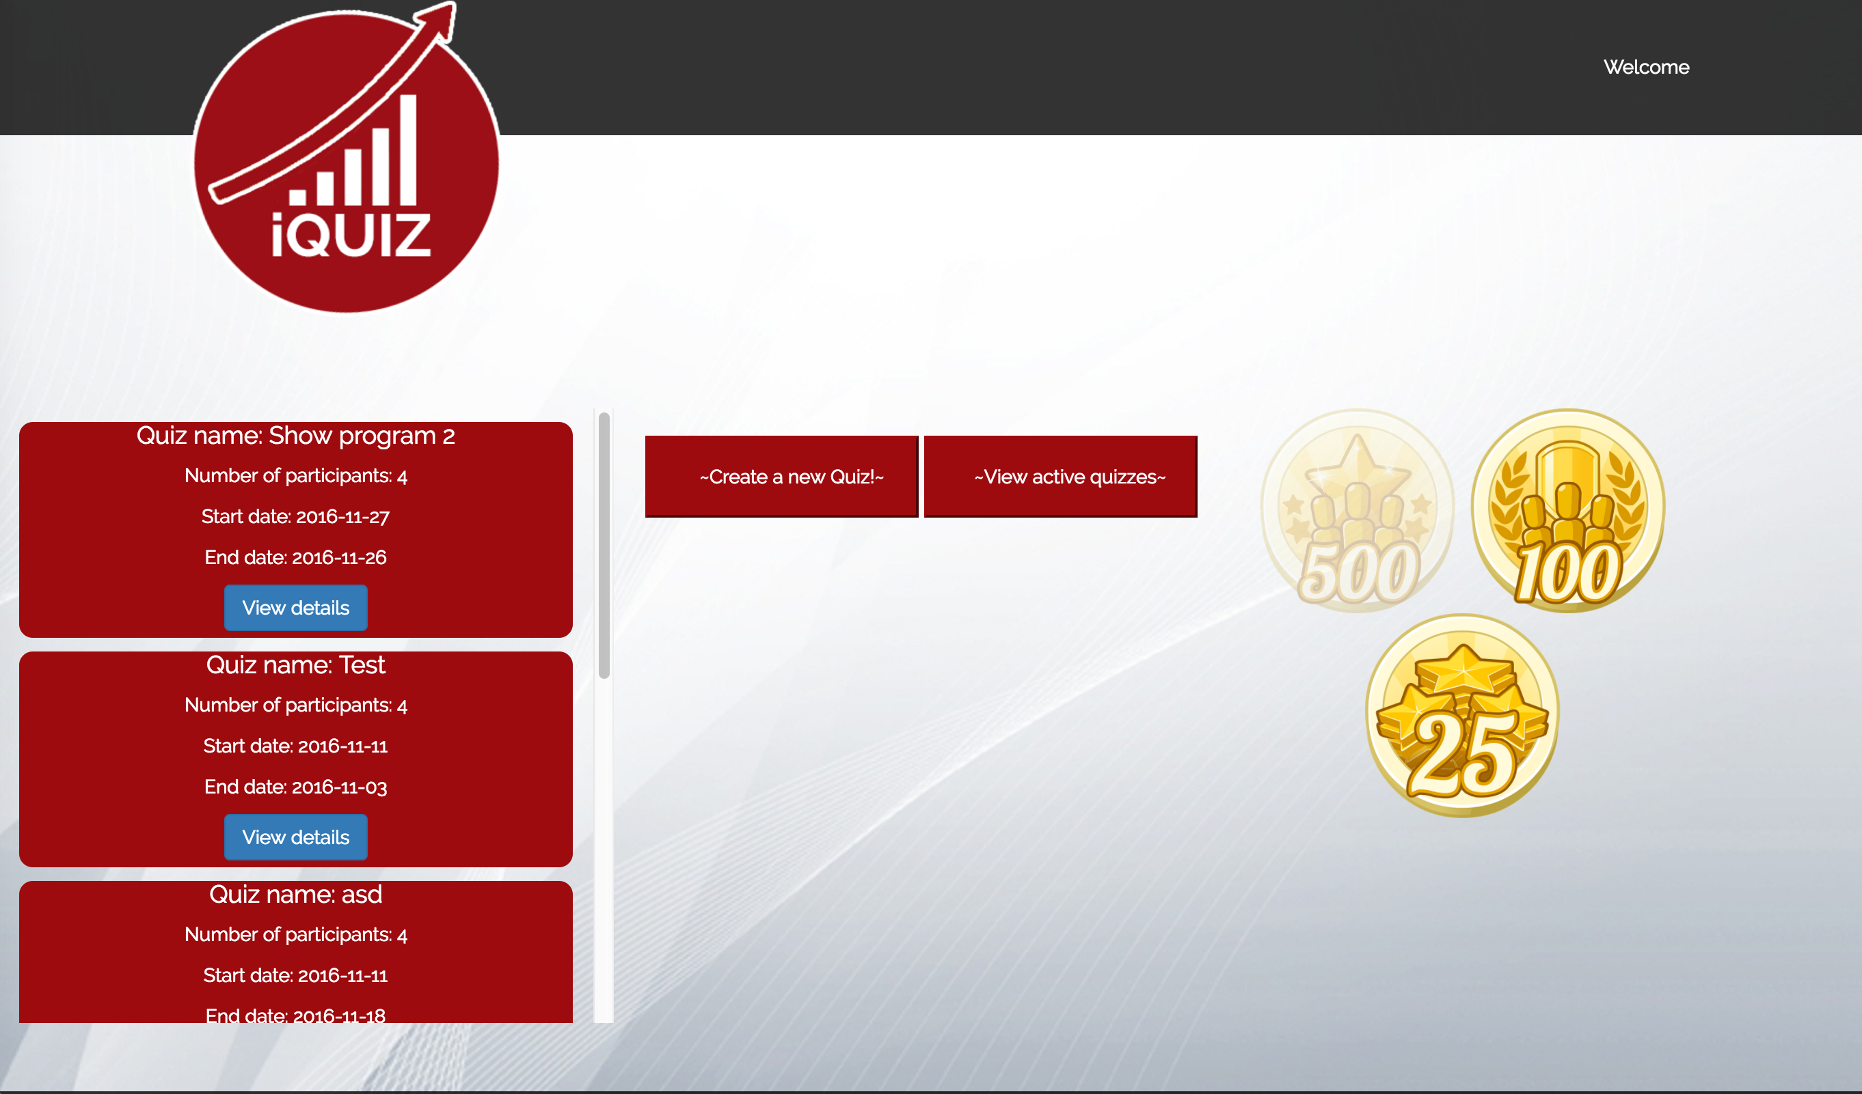

Slide 6
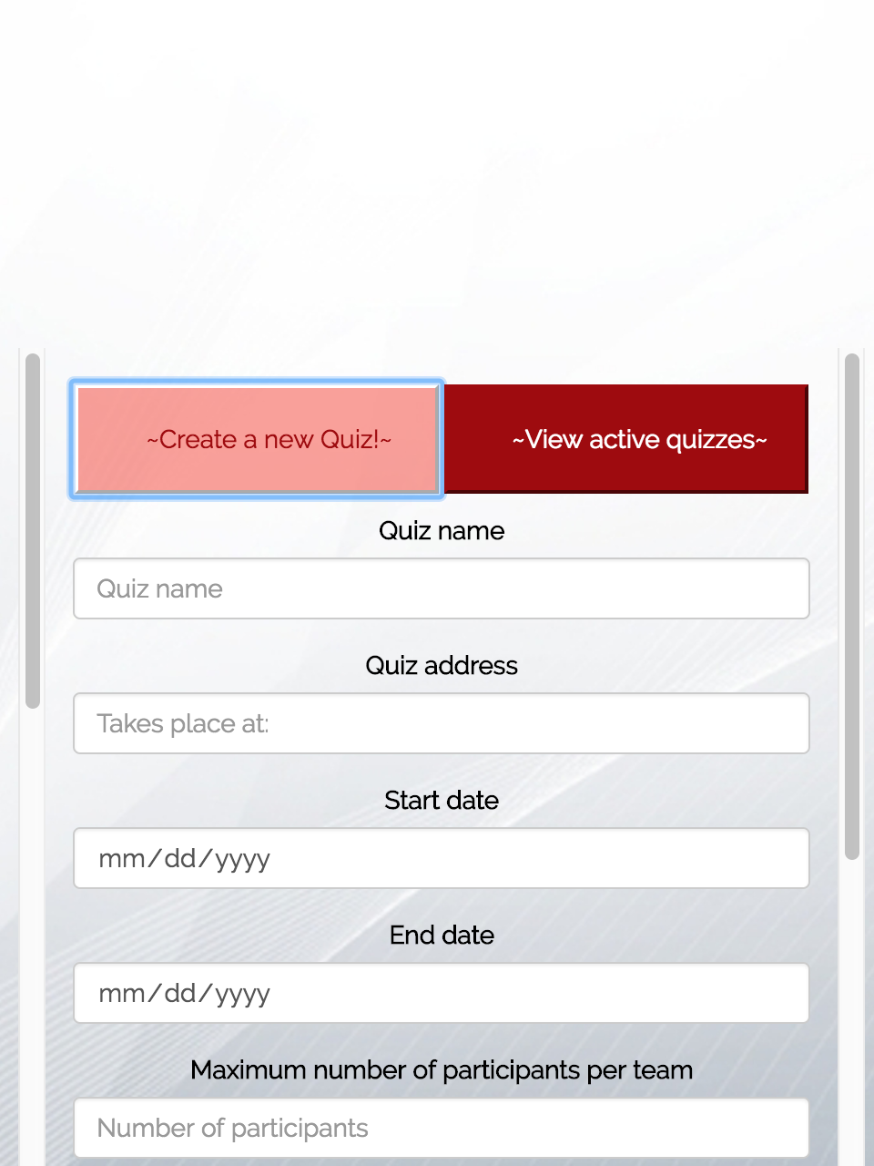
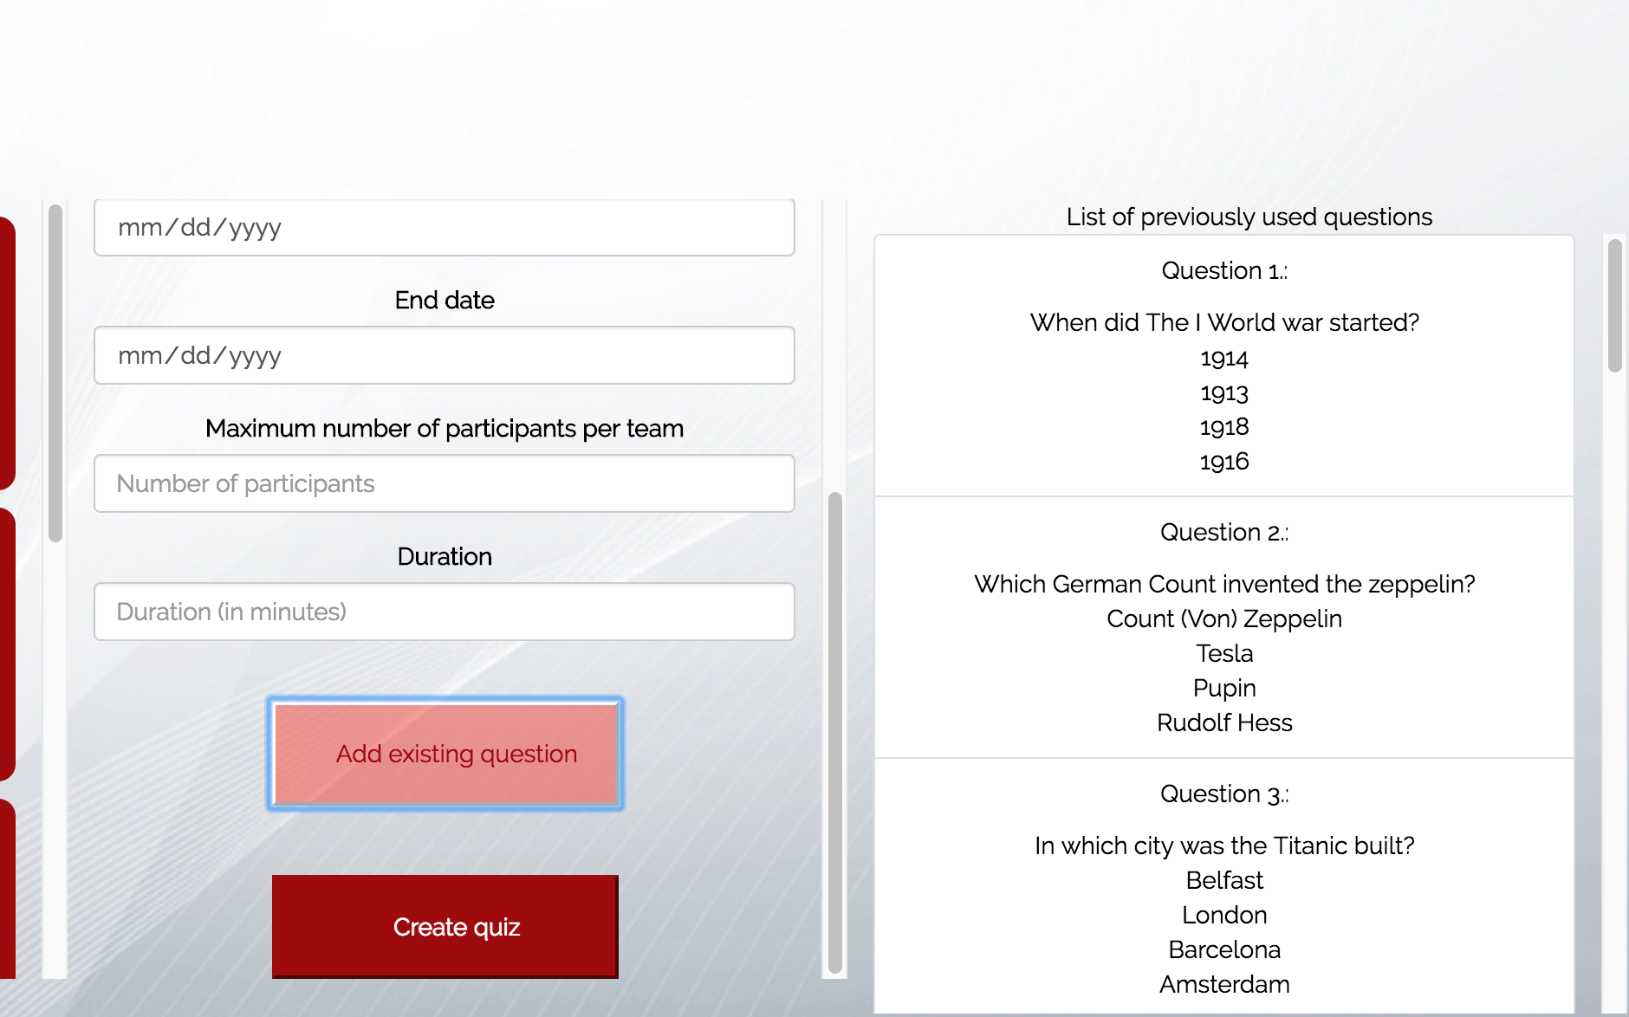

Slide 7
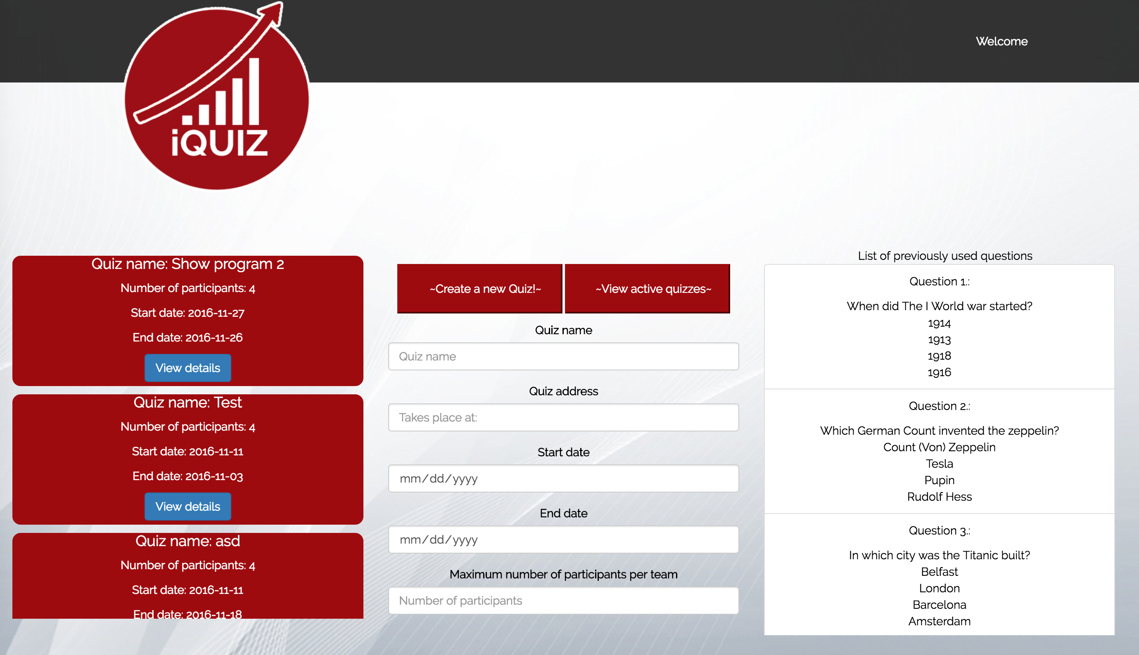

Slide 8
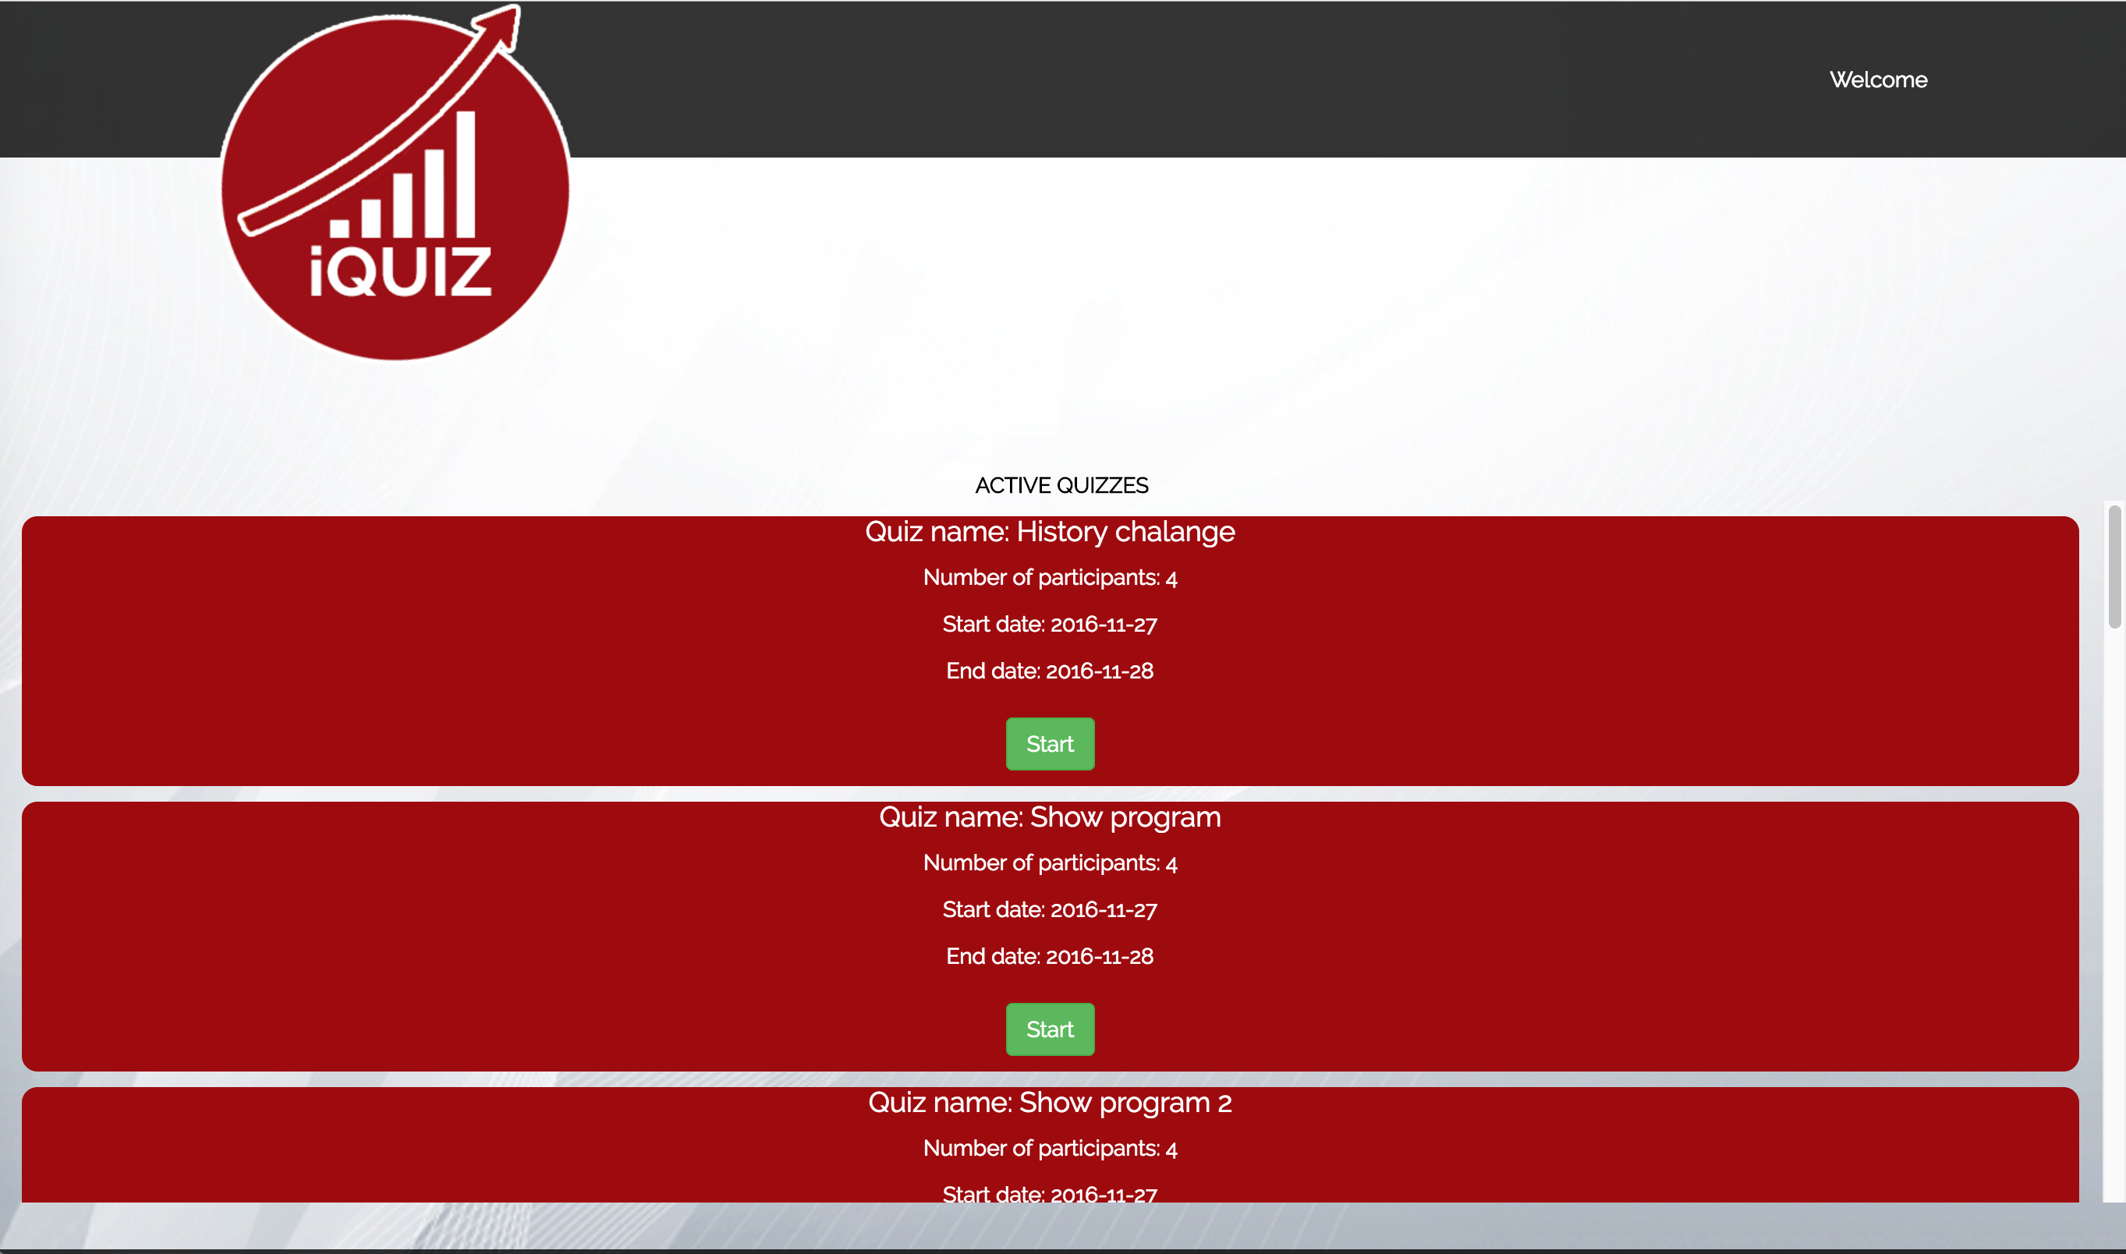

Slide 9
Mobile application
Easy social media login
Join or create a team
Join your teammates for more fun
Ready, steady, challenge yourself!

Slide 10
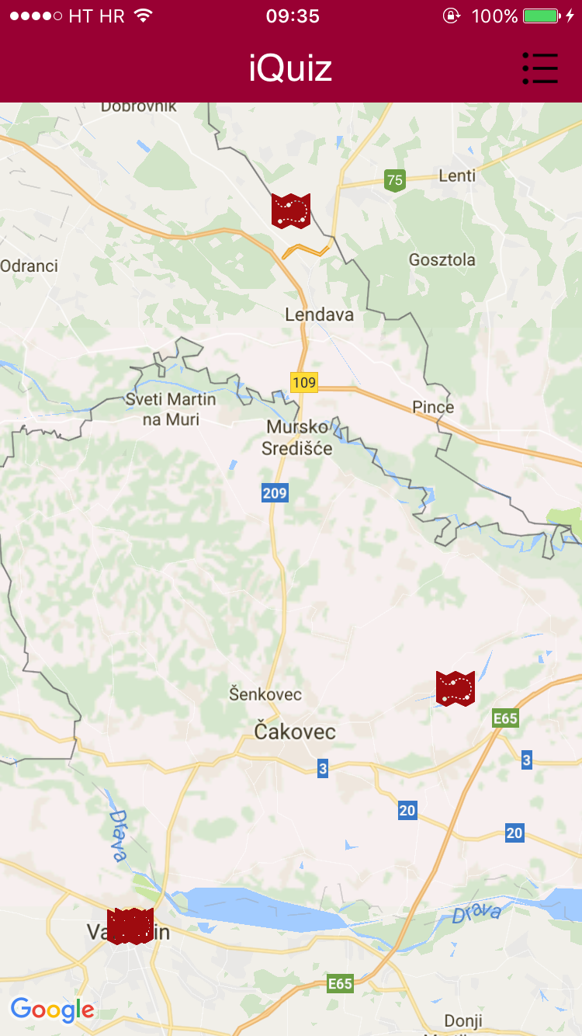

Slide 11
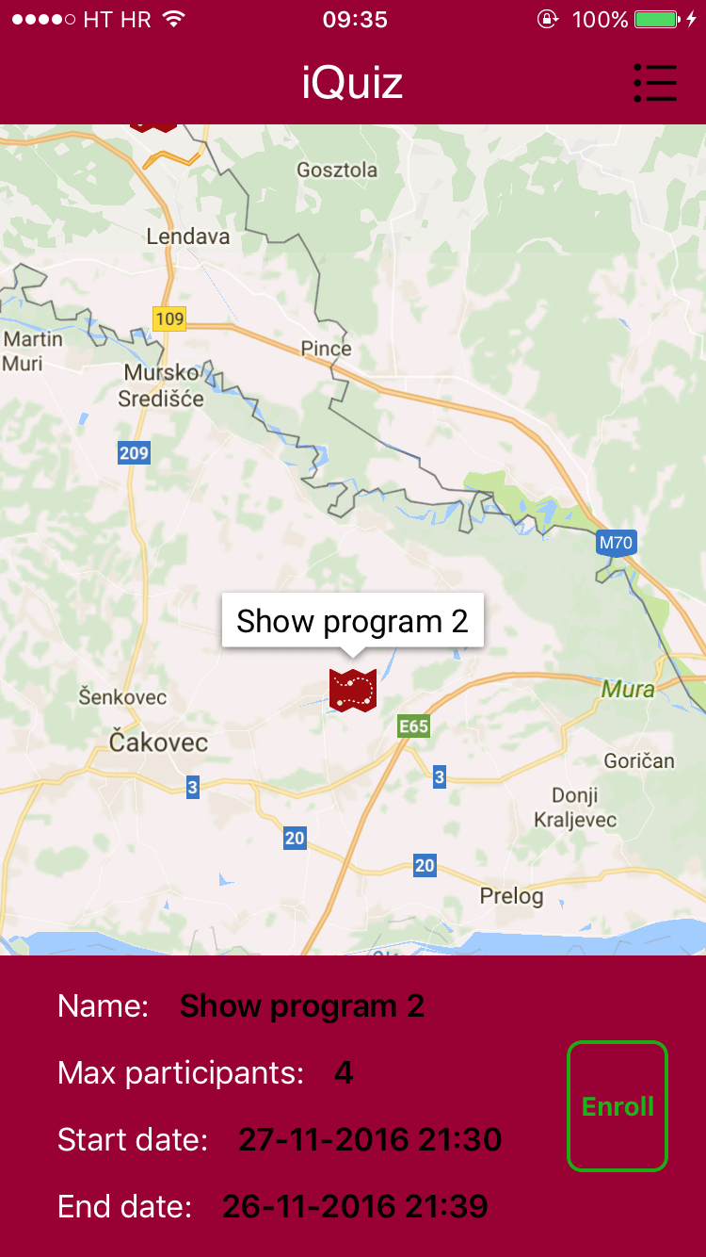

Slide 12
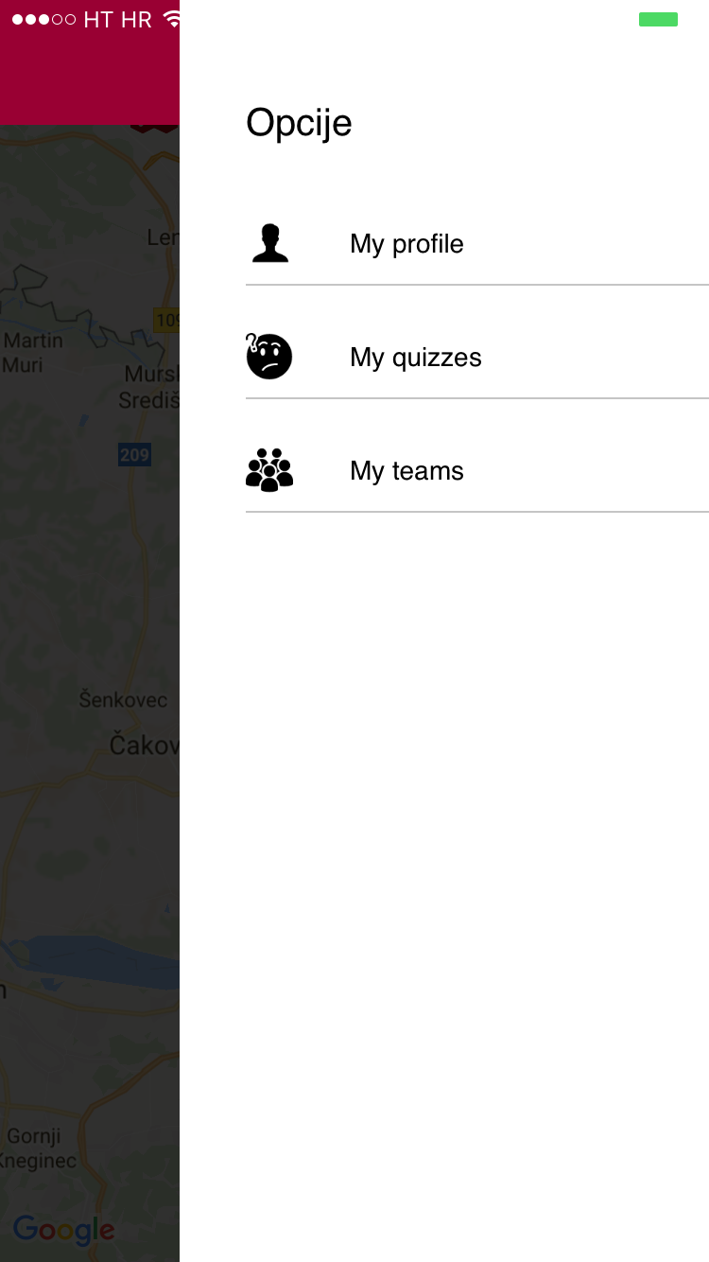

Slide 13
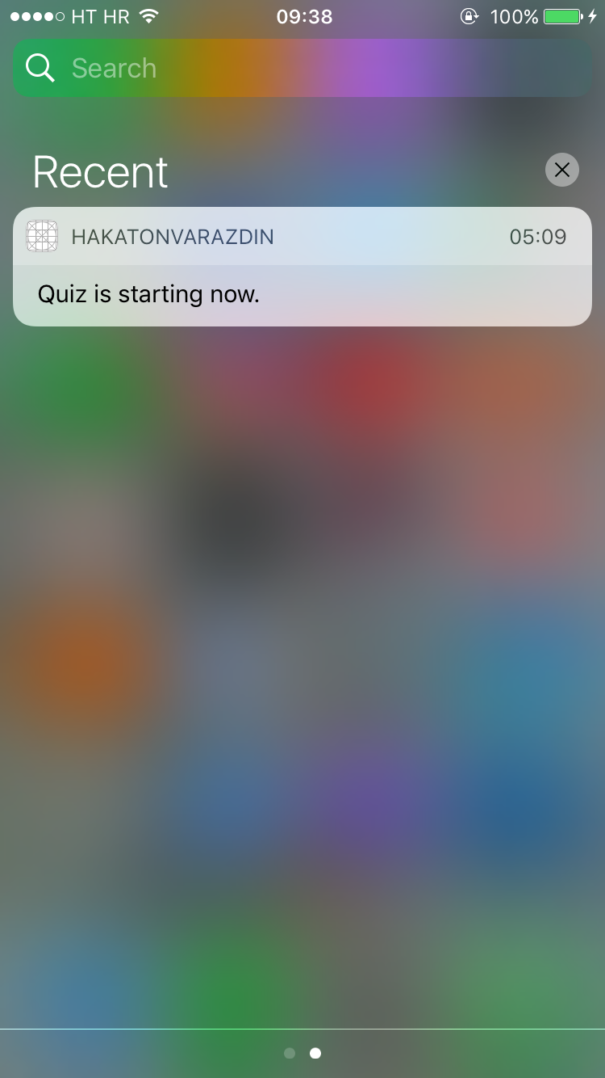

Slide 14
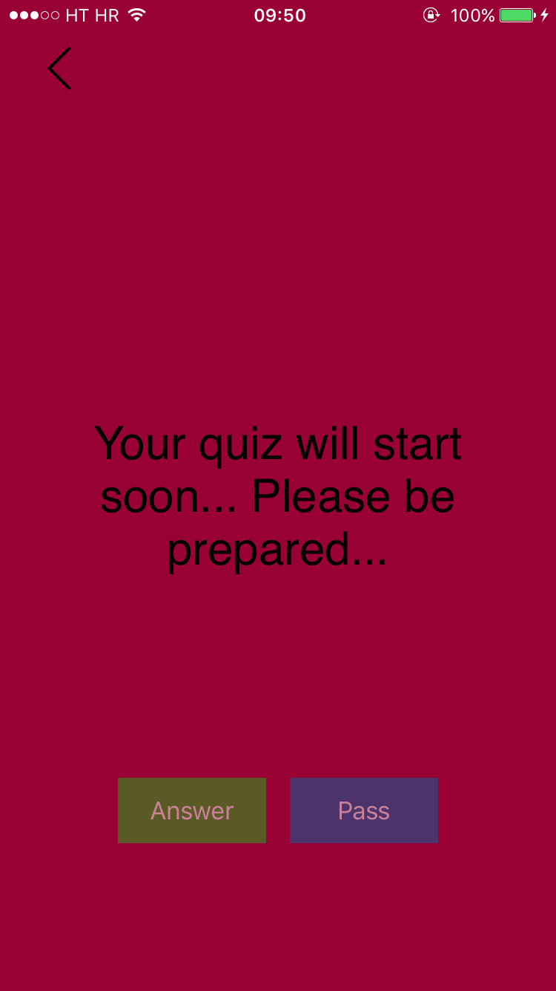

Slide 15
Cooperate in A team
All team member participate in the quiz
Individual questions are sent randomly
to the team members
Skip question and send
it to another team member
Collect your badges

Slide 16
Benefits
Business growth
Awards
Team work
Break your daily routine
Meet new friends and possibly, future teammates!

Slide 17
Any questions ?

Slide 18
Thank you for your attention! ☺

